Slide 1

An Information-Theoretic Definition of Similarity
Dekang Lin

Slide 2
Introduction
Similarity is a fundamental and widely used concept.
Information content [Resnik], mutual information [Hindle], Dice coefficient [Frakes and Baeza-Yates], cosine coefficient [Frakes and Baeza-Yates], distance-based measurements [Lee et al., Rada et al.], and feature contrast model [Tversky].

Slide 3
Definition of Similarity
Intuition 1: The similarity between A and B is related to their commonality.
Intution 2: The similarity between A and B is related to the differences between them.
Intution 3: The maximum similarity between A and B is reached when A and B are identical, no matter how much commonality they share.

Slide 4
Definition of Similarity
Assumption 1: The commonality between A and B is measured by I(common(A, B)) where common(A, B) is a proposition that states the commonalities between A and B;
Assumption 2: The differences between A and B is measured by I(description(A, B))- I(common(A, B)) , where description(A, B) is a proposition that decribes what A and B are.

Slide 5
Definition of Similarity
Assumption 3: The similarity between A and B sim(A, B), is a function of their commonalities and differences. That is, sim(A, B) = f(I(common(A, B)), I(description(A, B))).
Assumption 4: The similarity between a pair of identical objects is 1.

Slide 6
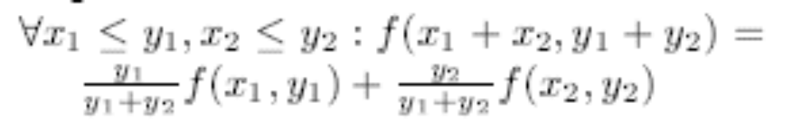
Definition of Similarity
Assumption 5: y > 0, f(0, y) = 0;
Assumption 6:

Slide 7
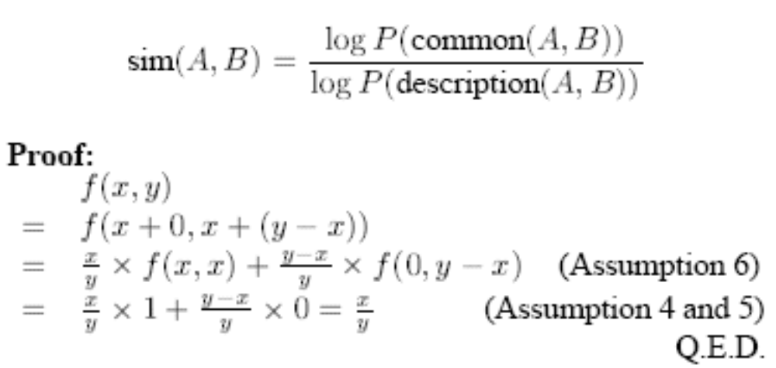
Similarity Theorem

Slide 8
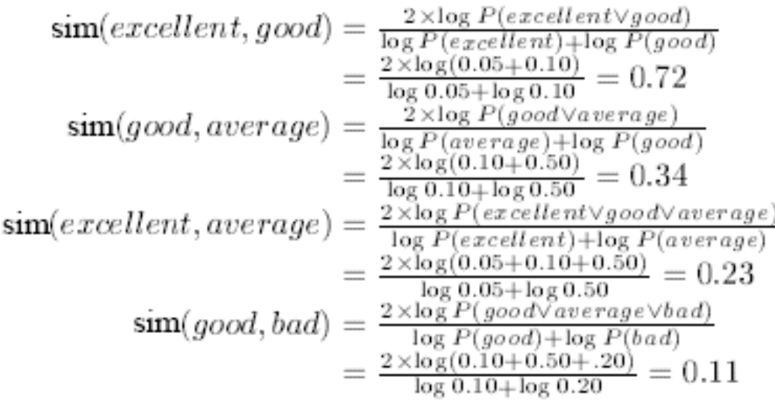
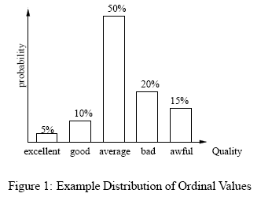
Similarity between Ordinal Values

Slide 9

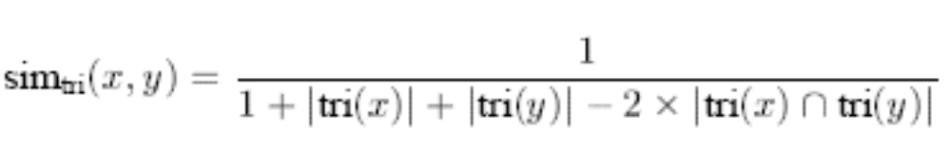
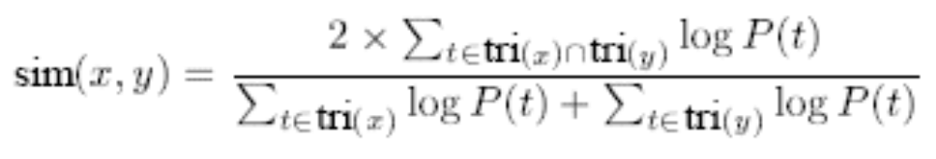
String Similarity

Slide 10
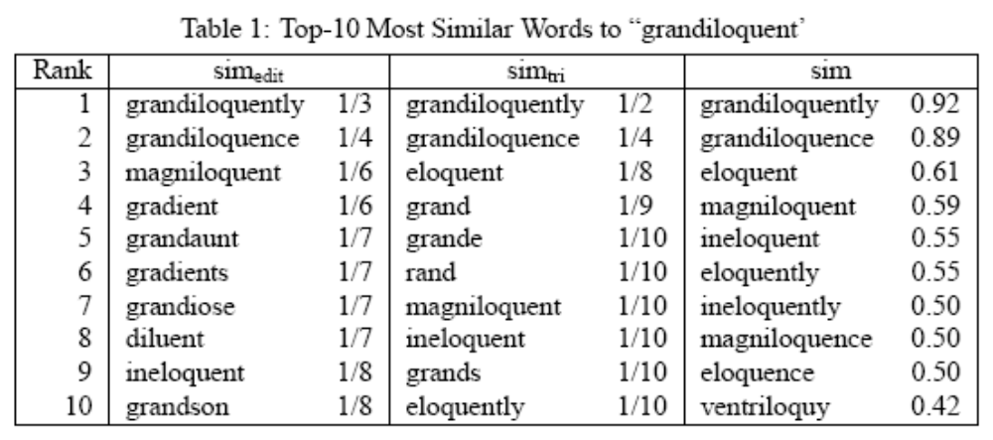
String Similarity

Slide 11

Word Similarity
Use a parser to extract dependency triples from the text corpus.
A dependency triple consists of a head, a dependency type and a modifier.
“ I have a brown dog”

Slide 12
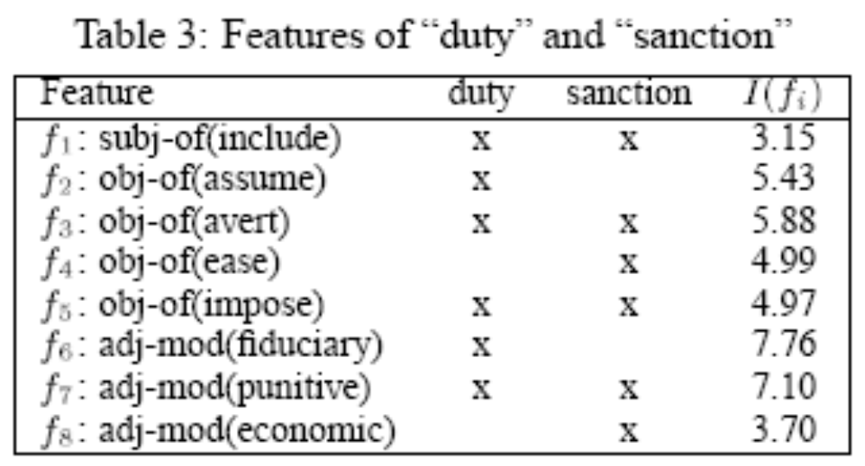
Word Similarity
Suppose ( avert obj duty ) is a dependency triple, we say that “duty” has the feature obj-of(avert) and “avert” has the feature obj(duty).

Slide 13
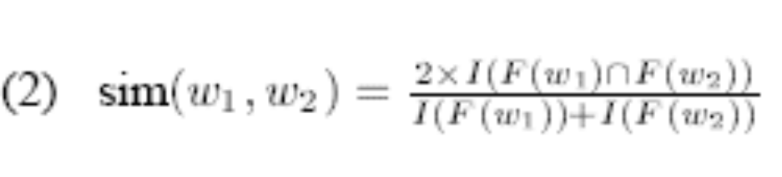
Word Similarity
Let F(w) be the set of features possessed by w. The commonalities between two words w1 and w2 is then F(w1)∩F(w2)

Slide 14
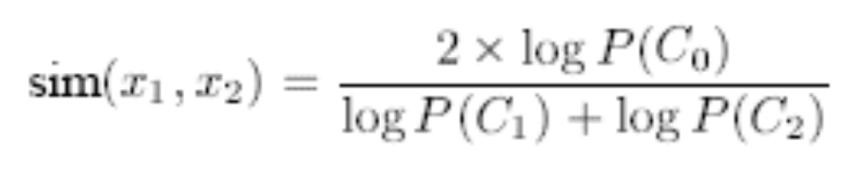
Semantic Similarity in a Taxonomy
Assuming that the taxonomy is a tree, if x1∈C1 and x2 ∈C2, the commonality between x1 and x2 is x1∈C0∧x2 ∈C0, where C0 is the most specific class that subsumes both C1 and C2.

Slide 15
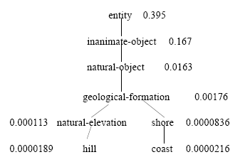
Semantic Similarity in a Taxonomy

Slide 16
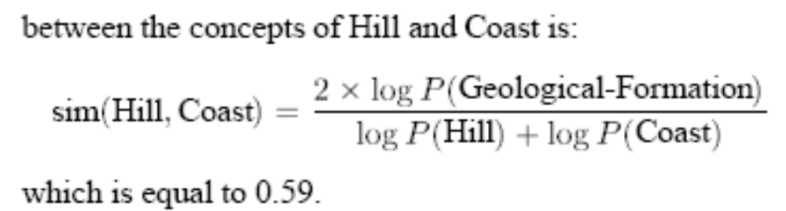
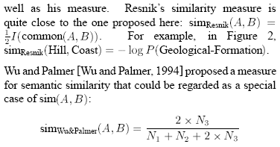
Semantic Similarity in a Taxonomy

Slide 17
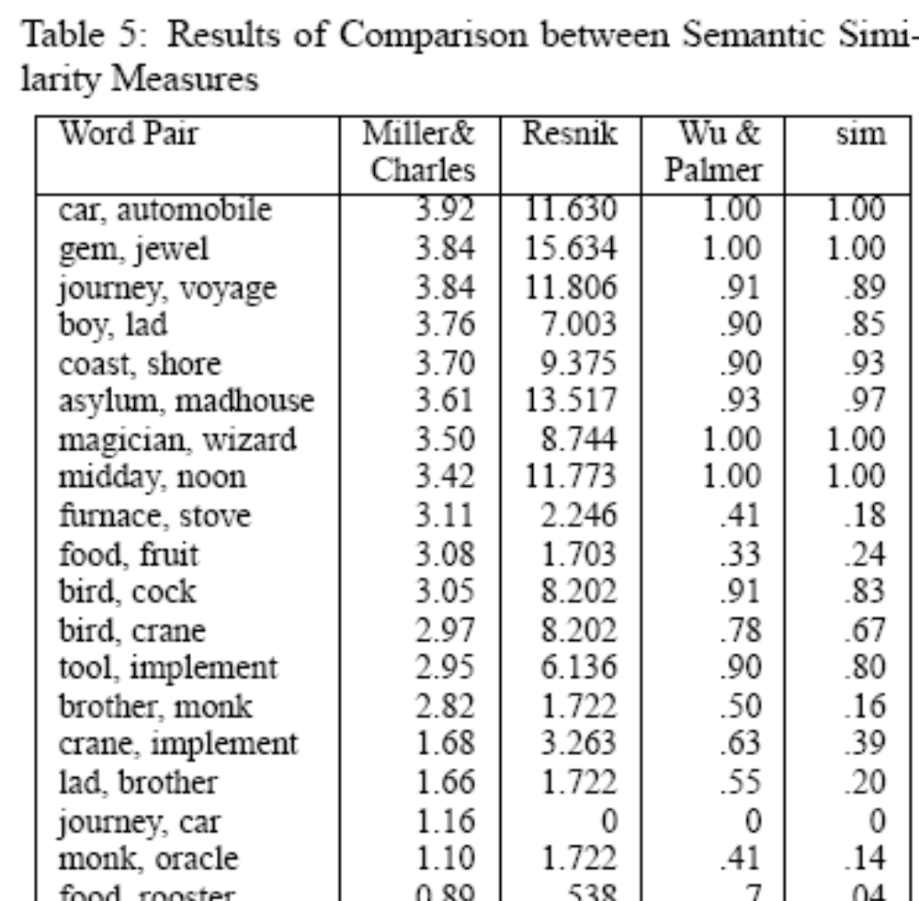

Slide 18
Comparison between Different Similarity Measures
Commonality and Difference: While most similarity measures increase with commonality and decrease with difference.

Slide 19
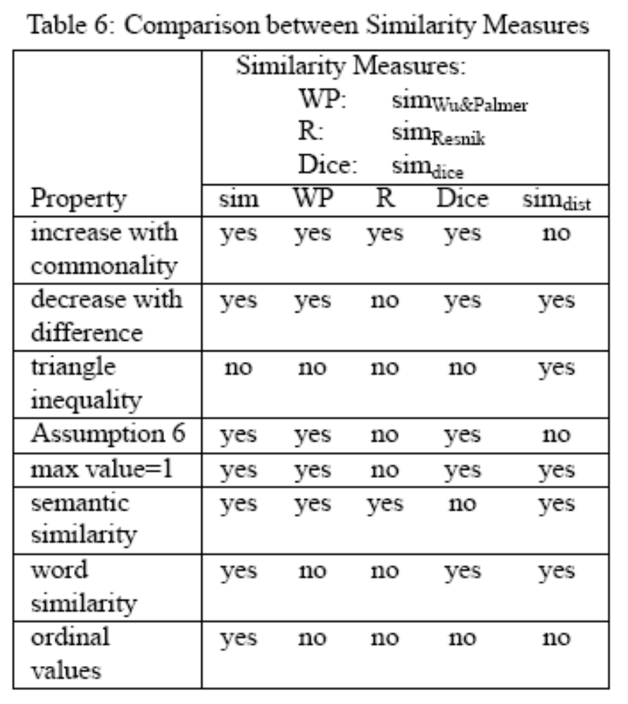

Slide 20
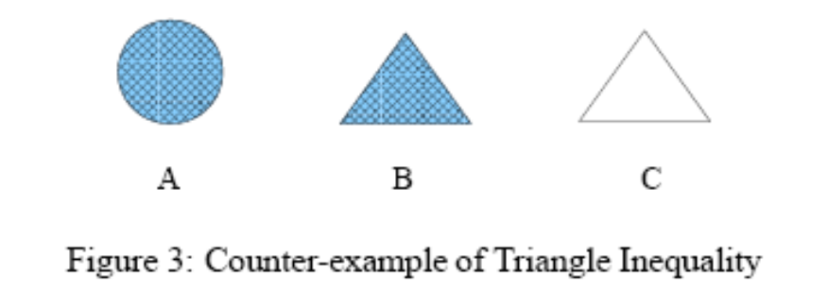
Comparison between Different Similarity Measures
Commonality and Difference: While most similarity measures increase with commonality and decrease with difference.
Triangle Inequality: A distance metrics must satisfy the triangle inequality: dist(A, C) ≦dist(A, B)+ dist(B, C)

Slide 21
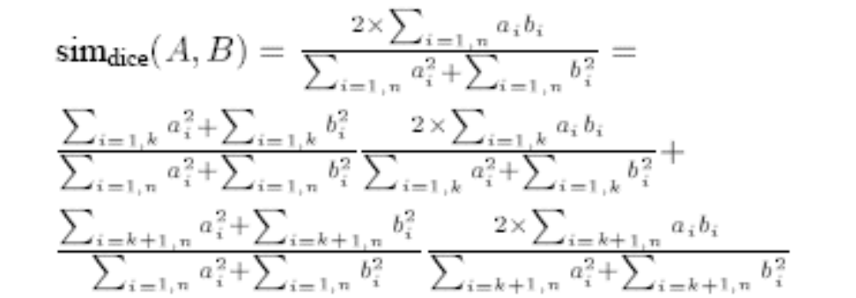
Comparison between Different Similarity Measures
Assumption 6: Suppose two objects A and B are represented by two feature vectors(a1, a2, …, an) and (b1, b2, …, bn). Without loss of generality, suppose the first k features and the rest n-k features represent two independent perspectives of the objects.

Slide 22
Conclusion
In this paper, present a universal definition of similarity in terms of information theory.
The similarity measure is not directly stated ad in earlier definitions, rather, it is derived from a set of assumptions. In other words, if one accepts the assumptions, the similarity measure necessarily follows.

Slide 23
Thanks~

